Slide 1
The big squeeze
Sequence compression progress
Roye Rozov - Lab meeting 31/10/12
Notes:
unmapped reads, large relative to compressed size, birney quote that not much benefit there

Slide 2
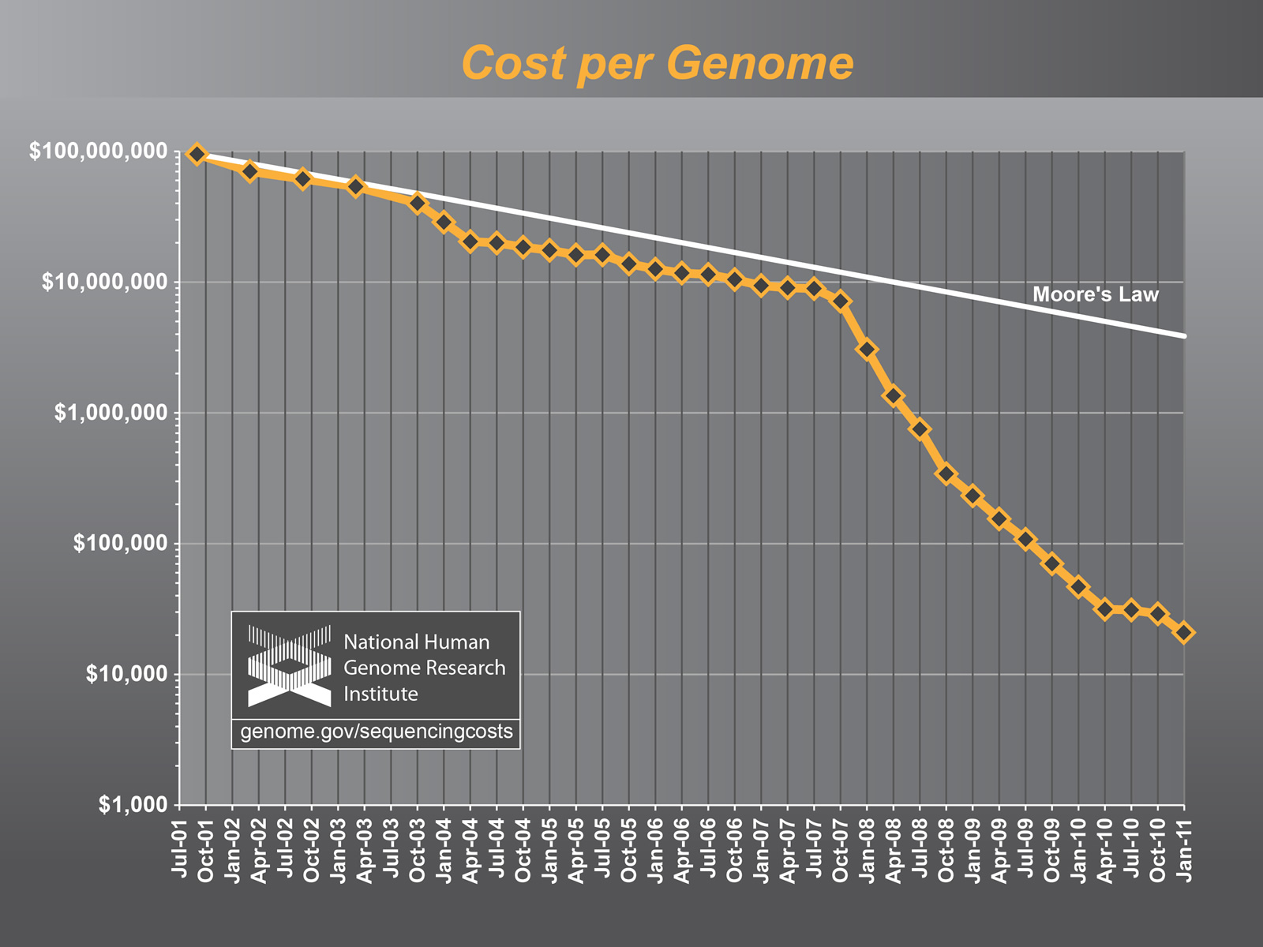
Sequencing trend
Notes:
-Moore’s law line is trend of halving cost every 18 months
-applies generally [?] to silicon chips – memory capacity as well as processing power
-cost of sequencing dropping much faster
- also reads getting longer, throughput bigger, results faster

Slide 3
Compression by reference
Sequencing outstripping pace set by Moore’s law
Identifying some associations require population scale projects – 1000G, encode, disease specific studies
Would like to be able to revisit experimental results later, not always feasible to store samples or sequence again
Can either throw away some data, repeat experiments by storing samples in refrigerators, or find better means of compression
Notes:
From quip:
While the cost of disk storage has [also] steadily decreased over time, it has not matched the dramatic change in the cost and volume of sequencing. A transformative breakthrough in storage technology may occur in the coming years, but the era of the $1000 genome is certain to arrive before that of the $100 petabyte hard disk … often researchers will be forced to maximize bandwidth by physically transporting storage media (via the ‘sneakernet’), an expensive and logistically complicated option. These difficulties will only be amplified as exponentially more sequencing data are generated, implying that even moderate gains in domain-specific compression methods will translate into a significant reduction in the cost ...

Slide 4
Compression by reference
Given reference sequence, information contribution of each read is small
By way of alignment, can store only position and differences relative to reference

Slide 5
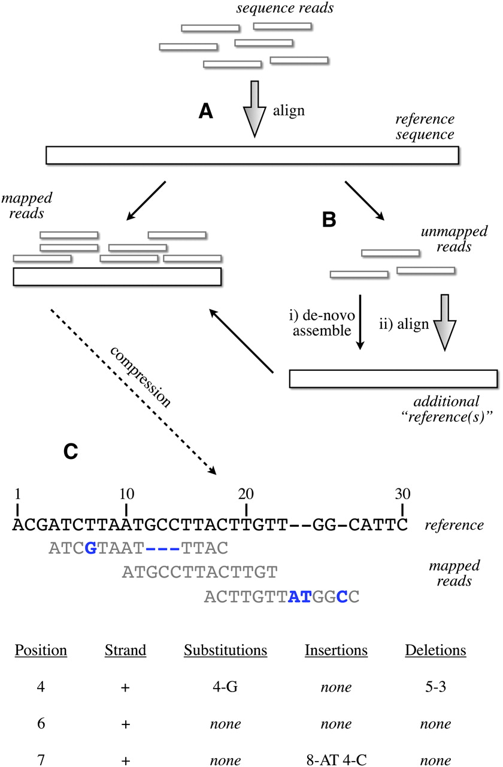

Schematic of the compression technique.
Hsi-Yang Fritz M et al. Genome Res. 2011;21:734-740
Copyright © 2011 by Cold Spring Harbor Laboratory Press
Notes:
Schematic of the compression technique. (A) Reads are first aligned to an established reference. (B) Unaligned reads are then pooled to create a specific “compression framework” for this data set. (C) The base pair information is then stored using specific offsets of reads on the reference, with substitutions, insertions, or deletions encoded in separate data structures.
-instead of storing l (~50-90) characters per read, we store one int for position and a few more chars to signify differences when they are present

Slide 6
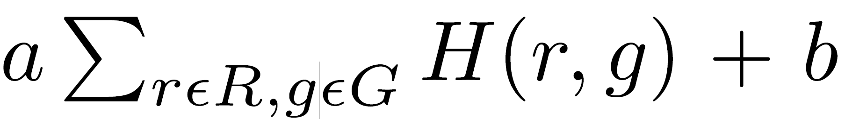
Cost model given a reference
Notes:
Inserted increasing number of mutations into E. Coli genome, simulated reads sampled from it, recorded storage cost in bytes

Slide 7
K-reference idea
Compress relative to k references instead of one
Rationale: SNP frequencies known to be population specific [IBD blocks]
Given many sequenced samples, assign each to one of k centers and compress relative to it

Slide 8
K-ref algorithm sketch
Input: alignment file (SAM/BAM typically), variant call file (VCF) providing known SNP positions and alleles for each sample
Pick k samples as references
For each genome window:
  Assign alleles from VCF files at SNP positions for each reference
  Calculate Hamming distances between VCFs from each sample to all references

Slide 9
K-ref algorithm sketch
For each genome window (cont'd):
  Assign each sample to the closest reference (center)
  Calculate consensus sequence of each cluster
  Use consensus sequence within each cluster as new centers, iterate (assignment/consensus calc) until no change in centers
given clusters, compress each set of reads relative to its cluster center

Slide 10
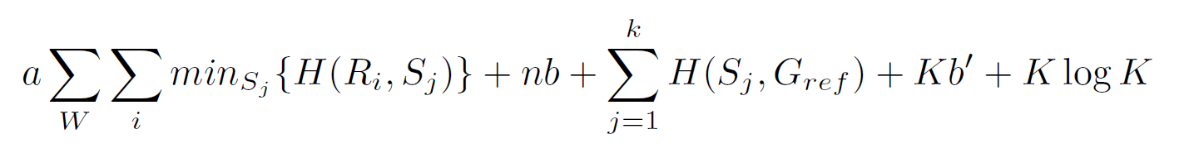
Cost model – k references
|W| log K
W – set of windows of fixed size, assumed same start/end for all individuals
S – set of k sequences used as references
b' – fixed cost for compact representation of read set variants
Notes:
Sum of diffs of reads relative to closest ref + n*fixed cost of read positions relative to ref + cost of k refs themselves + K * b’[?] + K * log K [?]
10

Slide 11
Attempt to reduce b
What to store?
  Options: Alignment positions, number of reads starting at each position, coverage at each position, coverage changes
Vector vs. linked list
Are changes observed after zipping?

Slide 12
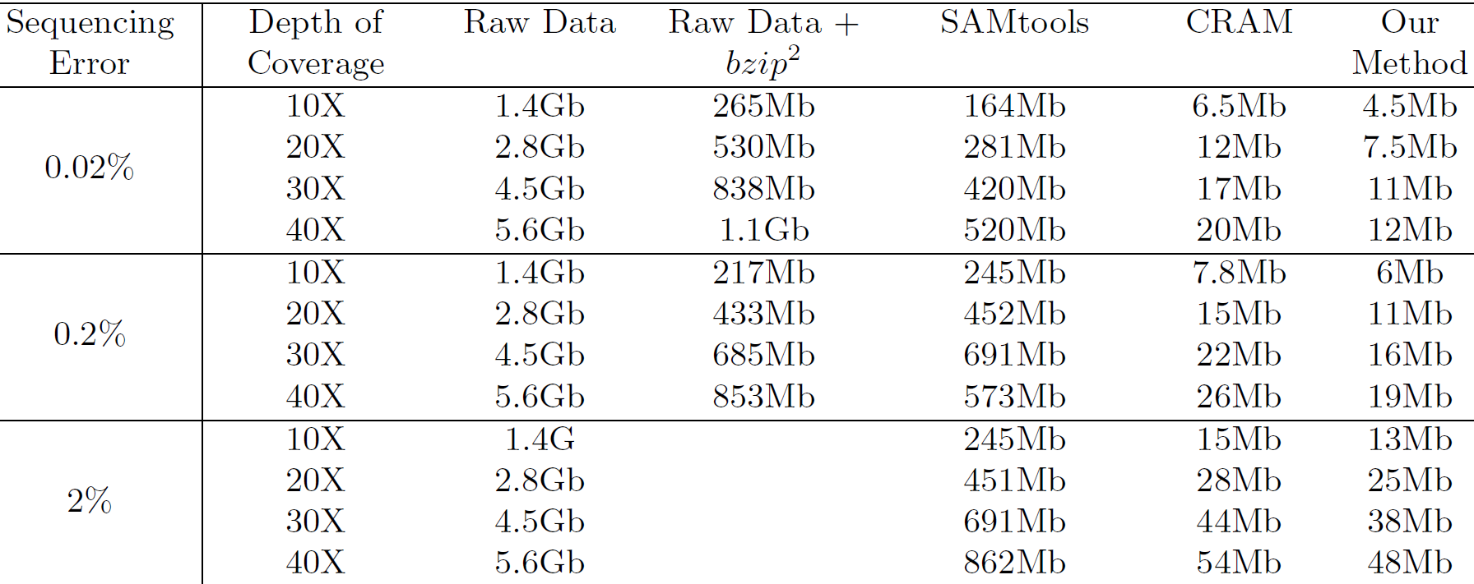
K-ref results

Slide 13
K-ref algorithm
Since k-means scheme is sensitive to starting point, repeat process several times and pick lowest total distance result (before compression)
Other choices can be used for clustering sequences
Compressed file sizes are 60-80% of state of the art CRAM tools, mainly due to taking advantage of SNP calling

Slide 14
1000G Unmapped reads
Size is typically significant fraction relative to compressed file size but small compared to original size (about 5-10% of original )
Possibly part due to structural variations (specific to populations?), some support for this in literature
Other parts could be technological artifacts (adapters at ends), pathogenic, bad runs (lane damaged), etc → fishing expedition
Expected the interesting biological part would only lead to marginal improvement in compression rate

Slide 15
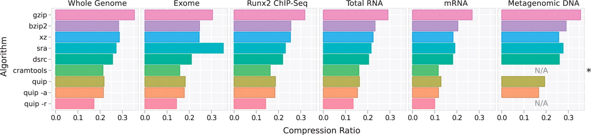
quip
Reference based compression or compression by bloom filter based rough assembly
Notes:
Came upon it while interested in performing population specific assembly on unmapped reads
Can work as reference based and can perform rough assembly

Slide 16
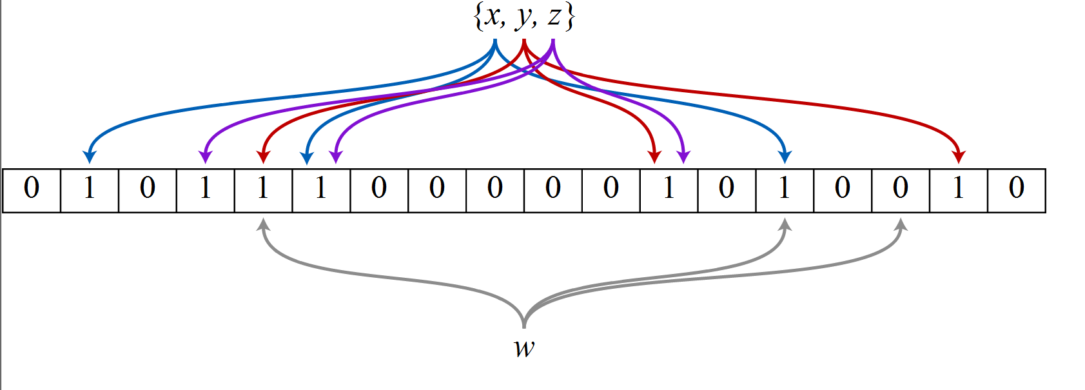
Bloom filter
m bit array to be stored vs. hash of kmers for de Bruijn graph
Add an element by applying j hash functions to get j array positions. Set bits at these positions to 1
Query by applying j hash functions as well – only if all return 1 accept (may be false positive)
In quip, counting variant is used to count kmers – uses incrementing instead of insertions, m integers instead of m bits to keep kmers with sufficient kmers and construct paths probable paths for assembly

Slide 17
Kmer graph sizes of individual samples vs. different sized pools
sample name | N50 | Max Node Size | Pooled |E| | Sum of separate |E|s
3 samp | 744 | 124475 | 152M | 160M
5 samp | 610 | 104639 | 248M | 265M
7 samp | 452 | 104639 | 278M | 401M
10 samp | 328 | 79437 | 450M | 561M
Notes:
-samples weren’t randomly sampled here: 1-3, 1-5, 4-10, 1-10
-now repeating on different data set

Slide 18
Idea: compression via shortest paths on de Bruijn graph – mmgc?
Construct Kmer graph of all samples sharing some common source
Encode reads as shortest paths on graph
  Each read recorded as start, end, branches taken
  Tradeoff: graph size vs. cost to encode each read: larger graph → less reads requiring branching information

